Slide 1
Simulation Based Transactive Energy - Spot, Forward and Investment Decisions
Chin Yen Tee
Martin Wagner
Marija Ilic

Slide 2

Smart Grid in a Room Simulator
Matlab algorithms
State-machine driven
Distributed simulation
Actor orientation
SGRS
Event - Driven
Scalability
DyMonDS*
Power system
Simulations
* Provisional Patent
Notes:
The Smart Grid in a Room Simulator is designed with several key ideas in mind - First, the simulator is actor - oriented, it is based on agent-based/object-oriented programming concepts, where each active component is an individual object. This facilitates distributed decision making, it also allows for simulations to be run on distributedly on computing clusters. It is event driven - we can set it up to simulate events happening at certain time. It is based of the DYMONDS concept for power system simulations, this is a distributed power system decision making framework developed in our research group. It is designed for easy scalability across computing resources. It is designed to work with MATLAB - which is a common tool in power system research. Finally, objects are designed to be state machines - I want to highlight this because I will talk more about this and it turns out that the state machine nature of the framework design makes it very easy to simulate distributed decision making across multiple time scale.

Slide 3
Vision of SGRS
Facility for researchers and policymakers to test novel, intelligent decision making frameworks, control designs, and institutional structures. Use case examples:
  Distributed automated modelling of power system dynamic [1]
  Retail market for reliability [2]
  Participation of electric vehicle in retail market [3]
Focus of Today’s Presentation:
Simulation-based Transactive Energy Market Design
Notes:
The overarching vision of the CMU-NIST Smart Grid in a room simulator is to provide a simulation facility for researchers to test and scale their algorithms to real world problem. Several algorithms from our research group has been tested on the simulator, the references for these can be found at the end of the presentation. The focus of today’s presentation is to demonstrate how simulation platforms such as the SGRS can be used for simulation -based Transactive Energy Market Design.

Slide 4
Multi Time-Scale Market Implementation on SGRS
Gen
+step():
State 0: Wait for Start Signal
State 1: Wait for Forward and RT Prices
Calculate Forward and RT market bids
Send Bids to ISO
Iterate
State 2: Wait for Estimated Future Price
Calculate Investment Bids
Submit Bids to ISO
Iterate
LSE
+step():
State 0: Wait for Load Series/Forecast
Send Signal To ISO Start Simulation
State 1: Wait for Forward and RT Prices
Calculate Forward and RT market bids
RT market bids for time t
Forward market bids for time t + T
Send Bids to ISO
Iterate
Transmission Owner
+step():
State 0: Wait for Investment Start Signal
State 2: Wait for Estimated Future Price
Calculate Investment Bids
Submit Bids to ISO
Iterate
ISO
+step():
State 0: Wait for Start Signal from LSE
Send Start Signal to Start Simulation
State 1: Wait for Forward and RT Bids
Clear Forward and RT Market
Send Dispatch and Prices
Iterate
State 2: Send Estimated Future Prices
Wait for Investment Bids
Clear Investment Market (If Appropriate)
Iterate
Additional Load Simulator object to generate load series and forecast

Slide 5
Test on 6 Bus Test System
1
5
Modified Garver 6 Bus Test System
Use NE ISO Historical Load Data to build load model
Generation and transmission investment under different market structure
  Spot Only
  Spot + Independent Investment and Forward Market
  Spot + Coordinated Investment and Forward Market
4
3
2
6
* Darker color: More expensive generation
**Blue line: Line 3 in results
Notes:
Spot + independent Forward Market: Forward Market clearing and investment decision done independently. Does not influence one another
Spot + Coordinated Investment and Forward Market: Forward Market clearing and investment decision are coordinated. Require iterative clearing
Blue thick line is line 3 - important for results

Slide 6
Independent vs. Coordinated Forward and Investment Markets
Independent Forward and Investment Markets
0
T
t
2t
T+t
T +2t
@ t: Spot Market for t, Forward Market for time T+t
@ 2t: Spot Market for 2t Forward Market for time T+2t
@T: Investment Market
Coordinated Forward and Investment Markets
0
T
t
2t
T+t
T +2t
@ t: Spot Market for t
@ 2t: Spot Market for 2t
@T: Investment Market + Forward Market for all t between T and 2T
Modular, state-machine driven simulation design makes it easy to implement different multi-timescale market design once basic framework has been established.

Slide 7
Differences in Investment Decisions
Case | Generation Investment | Transmission Investment
Spot Only | None | Investment in Line 3
Spot + Independent Forward | Investment in Gen 1 and Gen 6 | Investment in Line 3
Spot + Coordinated Forward | None | Investment in Line 3
Notes:
For independent forward market, forward market cleared based on “pre-investment” pricing, higher price → encourage investment (Investment in Gen 1 and Gen 6)
For coordinated forward market, forward market is coordinated with investment, account for effect of investment on market price → Investment in Gen 1 and Gen 6 no longer considered worthwhile by generator
Which one is better - depends on how we define better? We will see next some snapshot of forward and spot prices for the different schemes.

Slide 8
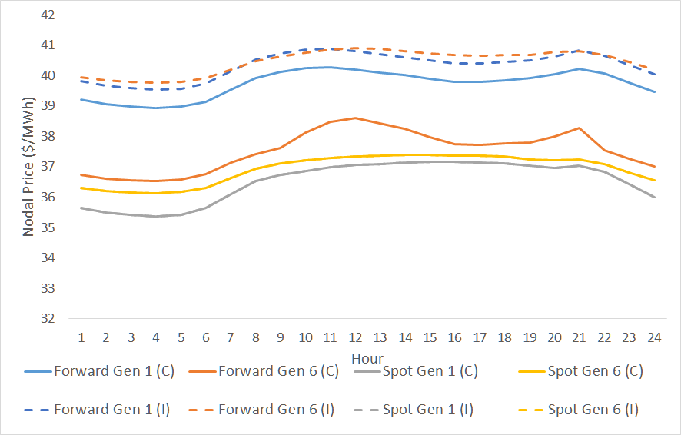
Comparison of Spot and Forward Price for Coordinated (C) vs Independent(I) Forward Clearing for Typical Load Days
Coordinated forward and investment clearing typically results in lower forward price as it accounts for effect of transmission/generation investment → Lower forward price discourages investment
Notes:
solid lines are for coordinated forward clearing, dashed line are for typical forward clearing. This graph shows that Coordinated forward and investment clearing typically results in lower forward price as it accounts for effect of transmission/generation investment → Lower forward price discourages investment. Explains the result earlier. This seems like coordinated clearing is better for everyone - but let’s take a look at the next slide, during peak load days.

Slide 9
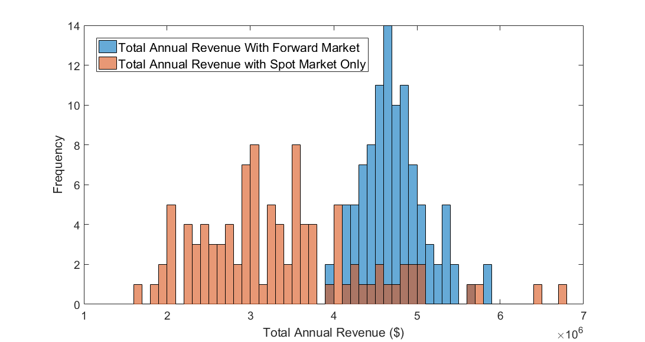
Generator 1 Revenue With and Without Forward Market for Case with Independent Forward Market (50 Real Time Load Realizations)
Forward market in this case results in higher generator revenue on average → market structure favors generator
Notes:
Given the high level of uncertainty of real time load, we run 50 real time load scenarios in order to evaluate the impact of forward market on expected distribution of generator revenue. At this point, forward market decision has been made, so the revenue variability is due to real time load uncertainty. As expected, the spot only market is more risky - has a greater spread. What is interesting here is the fact that forward market in this case results in higher generator revenue on average. What this indicate is that the market structure favors generators. (In power market, if generator is getting more money, load are paying more).

Slide 10
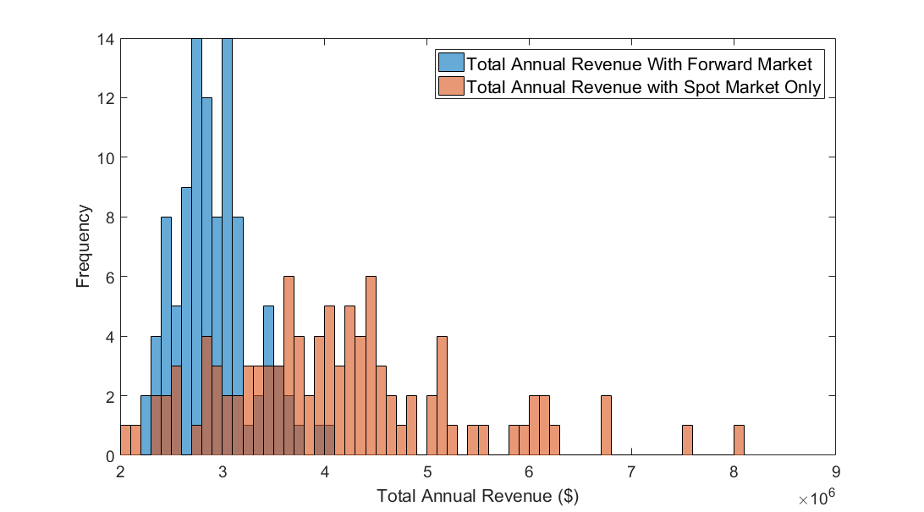
Generator 1 Revenue With and Without Forward Market for Case with Coordinated Forward Market (50 Real Time Load Realizations)
Forward market in this case results in lower generator revenue on average → market structure favors load (Recall that generator did not invest in this case)
Notes:
This is the opposite - market structure favors load.

Slide 11
Conclusion
Simulators such as the SGRS are well suited for simulation based market design for transactive energy markets
  Aid in understanding market effects (e.g. who wins/who loses)
  Aid in understanding interaction between markets at different time scales
  Help identify design questions for further evaluation
Modular, state-machine based simulation framework design makes it easy to quickly test different market structures once the basic framework has been established

Slide 12
References
[1]M. Wagner, K. Bachovchin, M. Ilic, "Computer Architecture and Multi Time-Scale Implementations for Smart Grid in a Room Simulator," 9th IFAC Symposium on Control of Power and. Energy Systems (CPES), New Delhi, India, December 2015.
[2] Siripha Junlakarn (2015),Retail Market Mechanism in Support of Differentiated Reliable Electricity Services, PhD Dissertation, Carnegie Mellon University
[3] Jonathan Donadee (2015), Operation and Valuation of Multi-Function Energy Storage Under Uncertainty, PhD Dissertation, Carnegie Mellon University

Slide 13
Extended Slide Deck
** Whitepaper to be released in June 2016. Email ctee@andrew.cmu.edu to request copy of whitepaper.

Slide 14
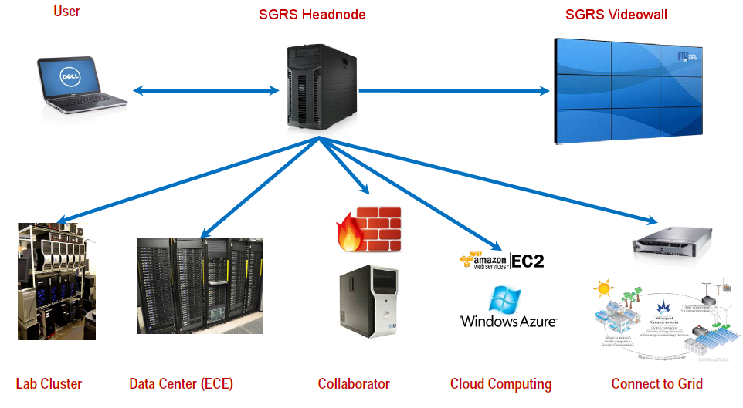
SGRS Platform Overview
Notes:
A user can connect from his laptop to the Simulation Framework by connecting to the SGRS Headnode. The Framework abstracts most of the complexity of distributed simulation from the User. Matlab scripts (implementing the communication interfaces) of the simulation algorithms divided into modules are sufficient to run distributed simulations within the framework. The framework is designed to be scale able – it runs on a lab cluster now, but will be able to scale up to cloud computing or connect to collaborators running confidential simulation entities on their own servers, connecting to the framework over the internet.
Also a connections to live measurements/real hardware will be handled by the framework.

Slide 15
Vision of SGRS
Facility for user/algorithm designers to test and scale their algorithms to real world problems. Use case examples:
  Distributed automated modelling of power system dynamic [1]
  Retail market for reliability [2]
  Participation of electric vehicle in retail market [3]
Focus of Today’s Presentation:
Simulation-based Transactive Energy Market Design
Notes:
The overarching vision of the CMU-NIST Smart Grid in a room simulator is to provide a simulation facility for researchers to test and scale their algorithms to real world problem. Several algorithms from our research group has been tested on the simulator, the references for these can be found at the end of the presentation. The focus of today’s presentation is to demonstrate how simulation platforms such as the SGRS can be used for simulation -based Transactive Energy Market Design.

Slide 16
Smart Grid in a Room Simulator
Matlab algorithms
State-machine driven
Distributed simulation
Actor orientation
SGRS
Event - Driven
Scalability
DyMonDS*
Power system
Simulations
* Provisional Patent
Notes:
The Smart Grid in a Room Simulator is designed with several key ideas in mind - First, the simulator is actor - oriented, it is based on agent-based/object-oriented programming concepts, where each active component is an individual object. This facilitates distributed decision making, it also allows for simulations to be run on distributedly on computing clusters. It is data driven - we can feed in external data for the simulation. It is based of the DYMONDS concept for power system simulations, which has a provisional patent. It is designed for easy scalability across computing resources. Finally, it is designed to work with MATLAB - which is a common tool in power system research.

Slide 17
Transactive Energy Market Design
Many different forms/proposals
  TeMix work of Ed Cazalet
  Double auction market (E.g. GridWise Olympic Peninsula Demonstration)
Fundamental ideas:
  Distributed decision making at value
  Multiple time-scale market
SGRS designed to manage these fundamental ideas to test different transactive energy market designs.
Notes:
There has been many different forms of Transactive Energy Market Design proposed. If we look at many of these proposal, we find that there are some fundamental ideas of transactive energy market. 1) It needs to enable distributed decision making at value. 2. It needs to support multiple time-scale market. SGRS is designed to manage both of these fundamental ideas, which allow us to test different transactive energy market design.

Slide 18
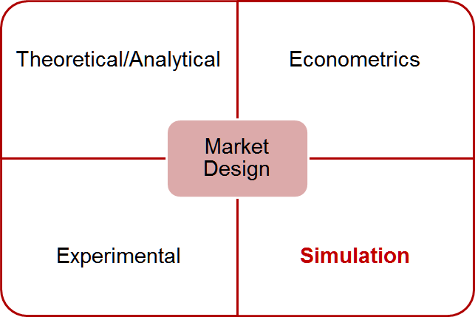
Simulation-Based Market Design
Notes:
[Probably delete this due to time constraints?]

Slide 19
Multi Time-Scale Market Implementation on SGRS
Gen
+step():
State 0: Wait for Start Signal
State 1: Wait for Forward and RT Prices
Calculate Forward and RT market bids
Send Bids to ISO
Iterate
State 2: Wait for Estimated Future Price
Calculate Investment Bids
Submit Bids to ISO
Iterate
LSE
+step():
State 0: Wait for Load Series/Forecast
Send Signal To ISO Start Simulation
State 1: Wait for Forward and RT Prices
Calculate Forward and RT market bids
RT market bids for time t
Forward market bids for time t + T
Send Bids to ISO
Iterate
Transmission Owner
+step():
State 0: Wait for Investment Start Signal
State 2: Wait for Estimated Future Price
Calculate Investment Bids
Submit Bids to ISO
Iterate
ISO
+step():
State 0: Wait for Start Signal from LSE
Send Start Signal to Start Simulation
State 1: Wait for Forward and RT Bids
Clear Forward and RT Market
Send Dispatch and Prices
Iterate
State 2: Send Estimated Future Prices
Wait for Investment Bids
Clear Investment Market (If Appropriate)
Iterate
Additional Load Simulator object to generate load series and forecast

Slide 20
Time Evolution on SGRS
T_start: “2008-01-01T00:00:00.0Z”
T_step: “PT60M”
LoadSimulator: LoadForecast:
LSE: LoadForecast
LSE,Gen: Bid
T1: “2008-01-01T01:00:00.0Z”
ISO: Dispatch&Prices
Operation Cycle (1 Hour)
LSE,Gen: Bid
T8760: “2009-01-01T00:00:00.0Z”
ISO: Dispatch&Prices
T2: “2008-01-01T02:00:00.0Z”
T8761: “2009-01-01T00:01:00.0Z”
Events
T8762: “2009-01-01T00:01:00.0Z”
ISO: EstimatedPrice
Wall Clock Time
Simulation Time
Trans,Gen:Investment Bid
T17520: “2010-01-01T00:00:00.0Z”
Investment Cycle (1 Year)
Step function of Object called
20

Slide 21
Test on 6 Bus Test System
1
5
Modified Garver 6 Bus Test System
Use NE ISO Historical Load Data to build load model
Generation and transmission investment under different market structure
  Spot Only
  Spot + Independent Forward Market
  Spot + Coordinated Investment and Forward Market
4
3
2
6
* Darker color: More expensive generation
**Blue line: Line 3 in results
Notes:
Spot + independent Forward Market: Forward Market clearing and investment decision done independently. Does not influence one another
Spot + Coordinated Investment and Forward Market: Forward Market clearing and investment decision are coordinated. Require iterative clearing
Blue thick line is line 3 - important for results

Slide 22
Independent vs. Coordinated Forward and Investment Markets
Independent Forward and Investment Markets
0
T
t
2t
T+t
T +2t
@ t: Spot Market for t, Forward Market for time T+t
@ 2t: Spot Market for 2t Forward Market for time T+2t
@T: Investment Market
Coordinated Forward and Investment Markets
0
T
t
2t
T+t
T +2t
@ t: Spot Market for t
@ 2t: Spot Market for 2t
@T: Investment Market + Forward Market for all t between T and 2T

Slide 23
Simulation Assumptions
Simulated 4 years - 3 investment cycles. 1 representative day per month simulated per year
Future prices/bids estimated based on a stochastic distribution of potential future load conditions
No investment lead time
Relatively simple bidding strategy used for testing
  Generation bidding is non-gaming. (i.e SRMC for spot market and LRMC for forward market)
  Load bids consist of fix and elastic portion. Load penalized if its forward load purchase is less than 80% of what it requires from the grid in real time.

Slide 24
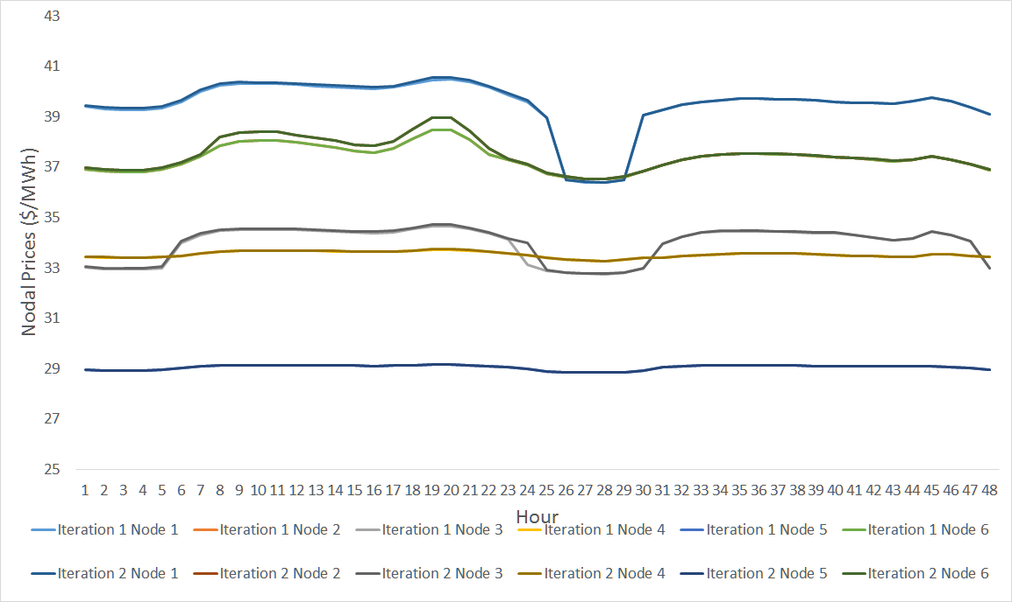
Nodal Prices for Coordinated Investment + Forward Iterative Market Clearing For Different Iteration
Converged in 3 Iteration. For convergence, need to impose rule that LSE bids have to be greater than the bids in the previous iteration. (Area for Further Study)
Notes:
Before we get into more detailed results, here is a demonstration of the iterative clearing of joint investment and forward market. Investment can have a significant impact on optimal forward market prices. Between this two iteration shown, new line have been built. Need bidding rule for convergence, otherwise, run the risk of bouncing between two points. Price low, load wants more load in increase bids, which increases prices, which encourages investment, but load decrease bids the next iteration, which cause price to drop and cycle continues.
Such rules consistent with what they find with auction theory for wireless spectrum. This is one area for further study that has been identified

Slide 25
Differences in Investment Decisions
Case | Generation Investment | Transmission Investment
Spot Only | None | Investment in Line 3
Spot + Independent Forward | Investment in Gen 1 and Gen 6 | Investment in Line 3
Spot + Coordinated Forward | None | Investment in Line 3
Notes:
For independent forward market, forward market cleared based on “pre-investment” pricing, higher price → encourage investment (Investment in Gen 1 and Gen 6)
For coordinated forward market, forward market is coordinated with investment, account for effect of investment on market price → Investment in Gen 1 and Gen 6 no longer considered worthwhile by generator
Which one is better - depends on how we define better? We will see next some snapshot of forward and spot prices for the different schemes.

Slide 26
Comparison of Spot and Forward Price for Coordinated (C) vs Independent(I) Forward Clearing for Typical Load Days
Coordinated forward and investment clearing typically results in lower forward price as it accounts for effect of transmission/generation investment → Lower forward price discourages investment
Notes:
solid lines are for coordinated forward clearing, dashed line are for typical forward clearing. This graph shows that Coordinated forward and investment clearing typically results in lower forward price as it accounts for effect of transmission/generation investment → Lower forward price discourages investment. Explains the result earlier. This seems like coordinated clearing is better for everyone - but let’s take a look at the next slide, during peak load days.

Slide 27
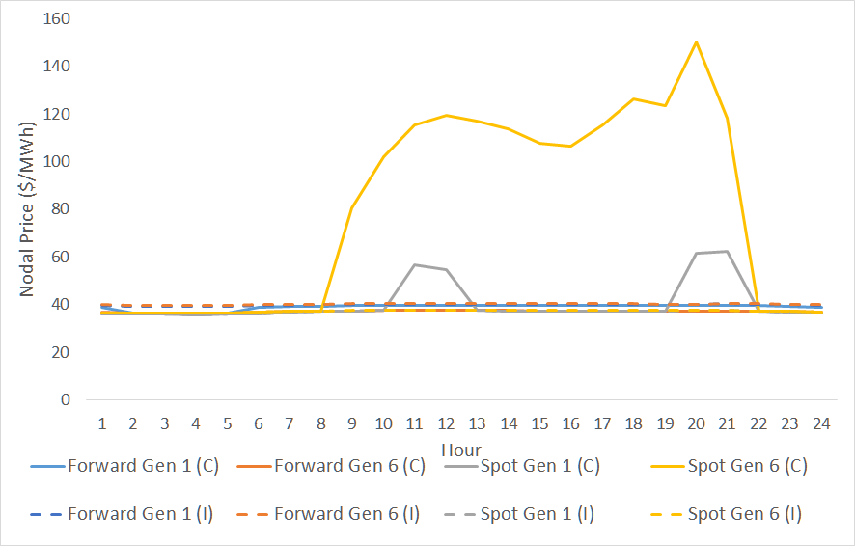
Comparison of Spot and Forward Price for Coordinated (C) vs Independent(I) Forward Clearing for High Load Days
In this case, this reduction in investment due to typically lower forward price results in greater volatility in spot prices for the coordinated case during peak load days.
Notes:
In this case, the reduced investment due to coordinated clearing result in greater volatility in spot prices for high load days. Forward market helps reduce the “pain” of spot price volatility - open research question here is what level of spot price volatility is acceptable.

Slide 28
Generator 1 Revenue With and Without Forward Market for Case with Independent Forward Market (50 Real Time Load Realizations)
Forward market in this case results in higher generator revenue on average → market structure favors generator
Notes:
Given the high level of uncertainty of real time load, we run 50 real time load scenarios in order to evaluate the impact of forward market on expected distribution of generator revenue. At this point, forward market decision has been made, so the revenue variability is due to real time load uncertainty. As expected, the spot only market is more risky - has a greater spread. What is interesting here is the fact that forward market in this case results in higher generator revenue on average. What this indicate is that the market structure favors generators. (In power market, if generator is getting more money, load are paying more).

Slide 29
Generator 1 Revenue With and Without Forward Market for Case with Coordinated Forward Market (50 Real Time Load Realizations)
Forward market in this case results in lower generator revenue on average → market structure favors load (Recall that generator did not invest in this case)
Notes:
This is the opposite - market structure favors load.

Slide 30
Conclusion
Simulators such as the SGRS are well suited for simulation based market design for transactive energy markets
  Aid in understanding market effects (e.g. who wins/who loses)
  Aid in understanding interaction between markets at different time scales (e.g. interaction between forward market and investment decisions)
Simulation aided market design helps identify design questions for further evaluation

Slide 31
References
[1]M. Wagner, K. Bachovchin, M. Ilic, "Computer Architecture and Multi Time-Scale Implementations for Smart Grid in a Room Simulator," 9th IFAC Symposium on Control of Power and. Energy Systems (CPES), New Delhi, India, December 2015.
[2] Siripha Junlakarn (2015),Retail Market Mechanism in Support of Differentiated Reliable Electricity Services, PhD Dissertation, Carnegie Mellon University
[3] Jonathan Donadee (2015), Operation and Valuation of Multi-Function Energy Storage Under Uncertainty, PhD Dissertation, Carnegie Mellon University

