Slide 1
A Reusable and Extensible
Web-Based Co-Simulation Platform for Transactive Energy Systems
C2WT-TE:
HIMANSHU NEEMA
himanshu@isis.vanderbilt.edu
Co-Simulation Team, TE Challenge
May 19, 2016

Slide 2
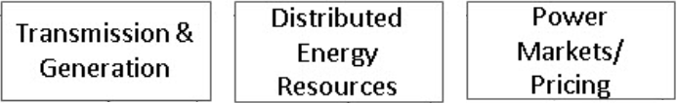
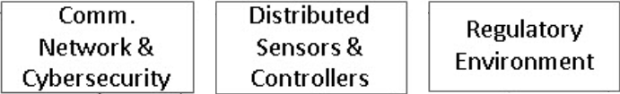
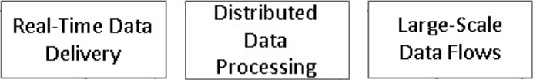
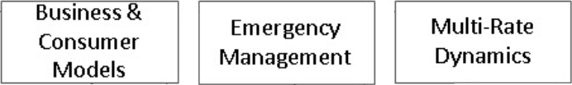
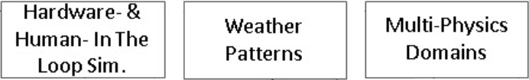
Analyzing Impact of TES Integration – 1/2
TES integration will be great, but the fundamental questions are: what is a good way to integrate, how could the grid operations get impacted, and how can utilities gain enough confidence in order to roll it out?
The only way to gain confidence is through comprehensive grid-scale “multi-faceted” modeling and simulation.
Co-simulating just the power grid communication network is simply not enough.
We need to analyze dynamic impacts of supply and demand with transients and cascading faults.
Truly, we really need to consider all of these facets “simultaneously” because variations in one can introduce cascading, potentially disastrous, effects in the other.
Even this is not enough!!

Slide 3
Analyzing Impact of TES Integration – 2/2
We need support for What-ifing built into the core of the platform. We need ways to design and evaluate complex Courses of Actions (COAs)/scenarios/business models.
This requires multi-organizational level collaborative decision making and multi-user modeling and collaboration (Secure google docs for power grid modeling and analysis)
A single tool hasn’t been enough, has never been, and won’t be! What’s really needed is a platform that is customizable and extensible. Stakeholders have different needs and highly customized tools that they need to integrate – the platform should be “open” for any such extensions.

Slide 4

What core technology pieces are needed?
What we really need…
..is a simple flower ☺
Artist & Copyright:
Himanshu Neema

Slide 5
The Co-Simulation Platform Flower!
Model-based rapid distri. sim. composition
Meta-modeling, DSMLs, Tools, Infrastrctr
Scenario-based expt
Courses of Actions (COAs)
What-ifs
Time Mgmt
Distri Obj Mgmt
Distri Fedn Mgmt
& Orchestration
Human/H/w IL
Monitoring
& Control
Debugging
Analysis tools
Experimentation
Runtime/Deplymt
Build System
Automation
Access Ctrl/Auth
Multi-User Env.
Persistence
Versioning
Traceability
Cybersecurity analysis
Cyber (S/w) analysis
Artist & Copyright:
Himanshu Neema
Model libraries
Experiment libraries
Open Architecture
Flexibility
Customizability
Extensibility

Slide 6
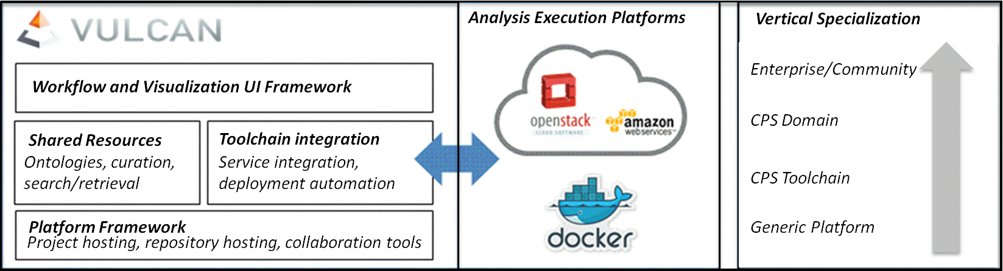
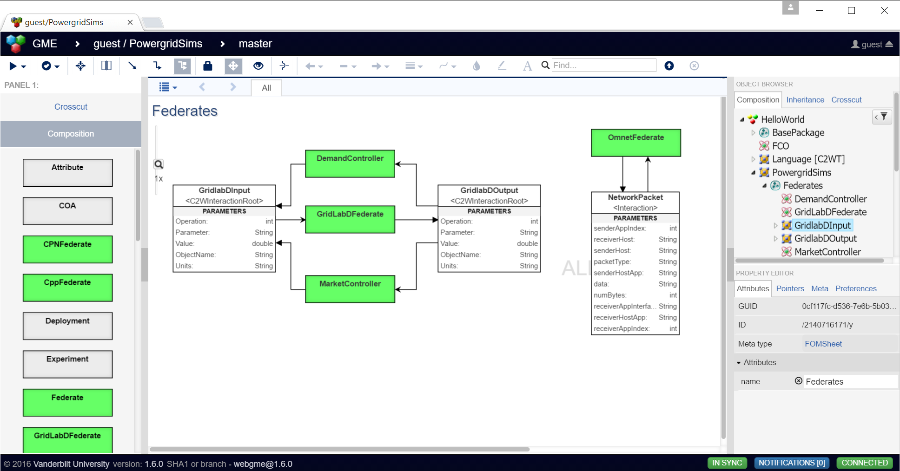
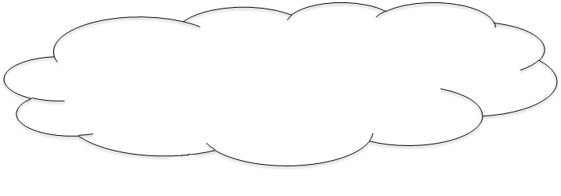
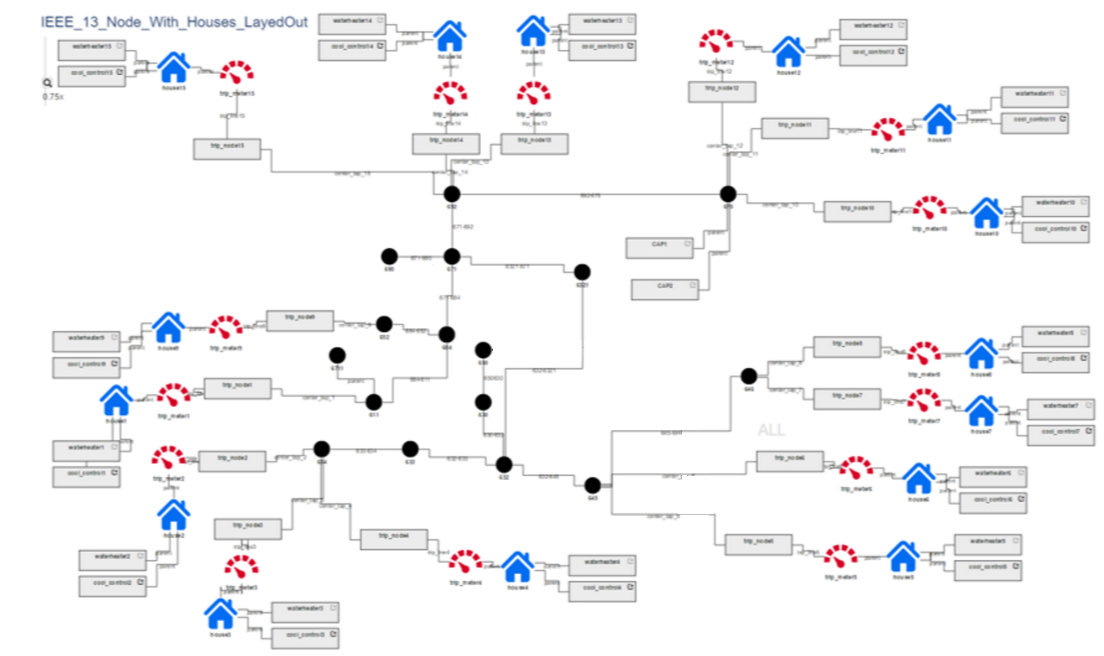
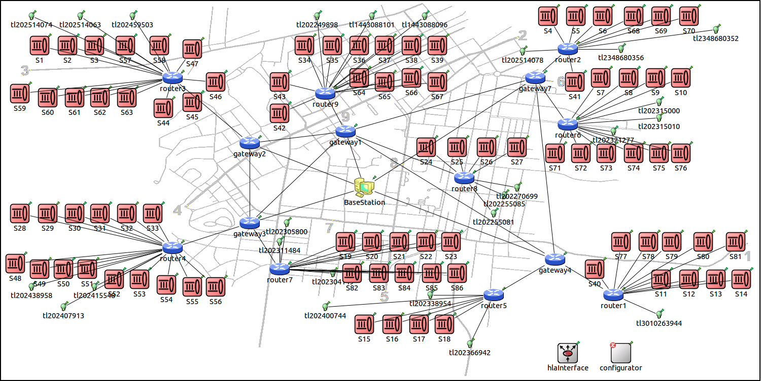
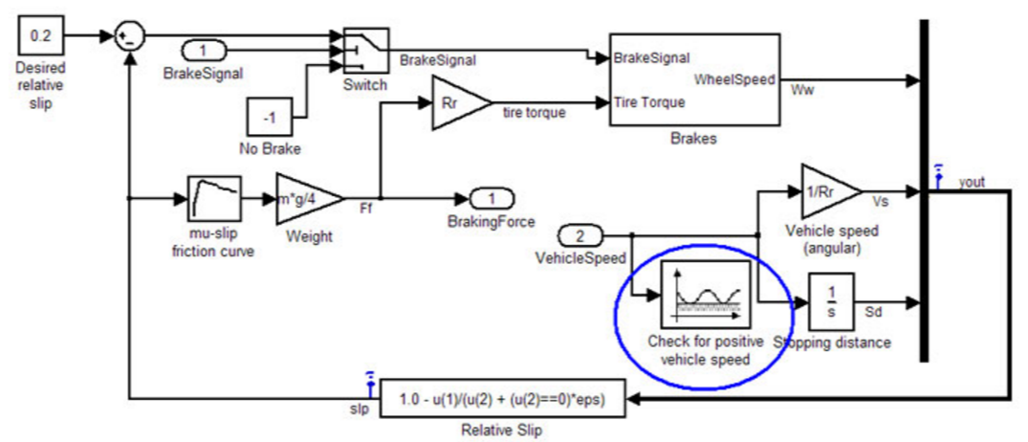
How does it all work in C2WT-TE?
VULCAN Collaboration Platform:
Projects, Users, Groups, Tools, Models, Repositories, Collaborative Exchange, Execution Environments
WebGME multi-user M&S:
Domain-Specific Modeling Languages, Scenario/COA language, multi-user modeling (Google docs), Integrated Deep Repositories, Integrated Build Systems, Analysis Tools
Execution Cloud
Cloud-Based Execution:
Auto. Cloud Deployment, Experiment Monitoring, Control, and Analysis, Results Management, Error Handling, Traceability, Persistence
Gridlab-D Distri. Model in WebGME
Comm. Network Model in OMNeT
Simulink Ctrllr model in Matlab

Slide 7
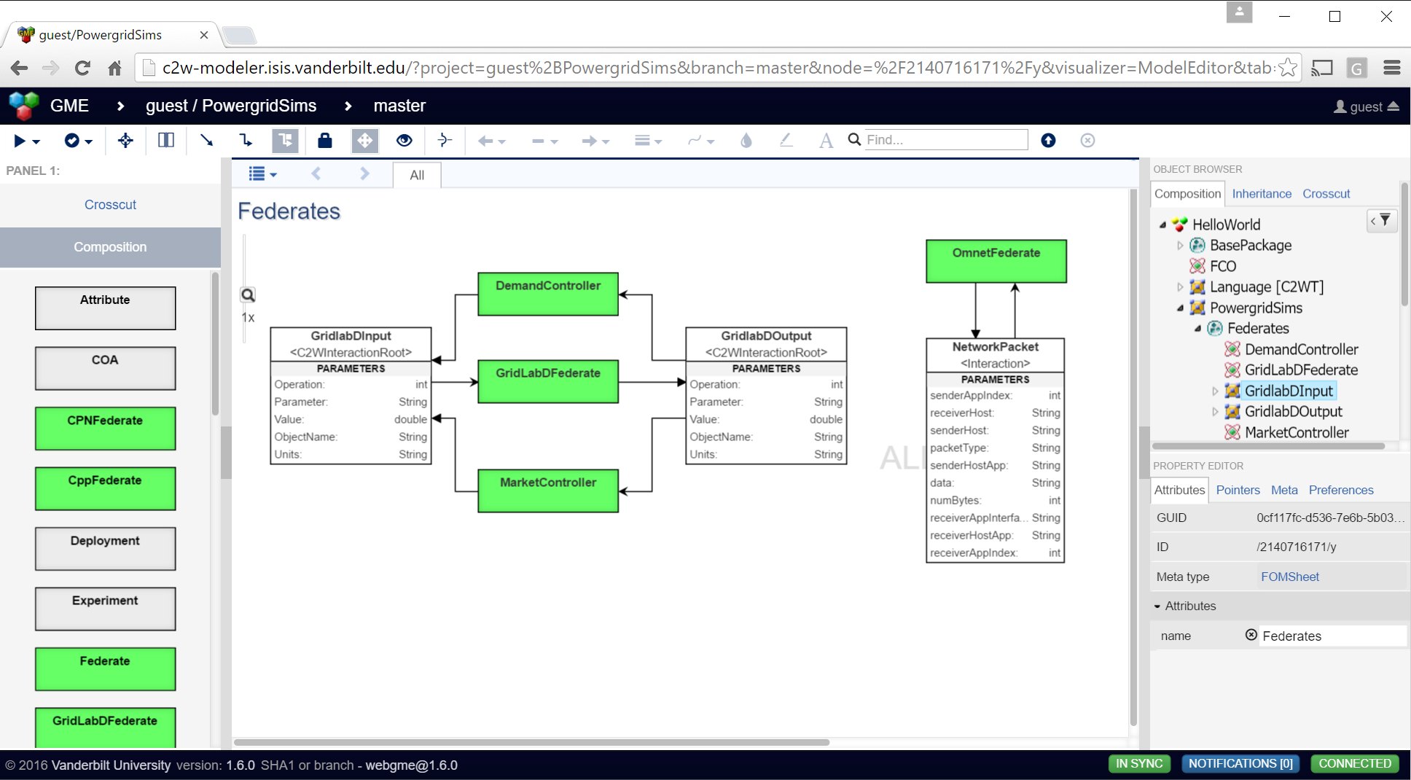
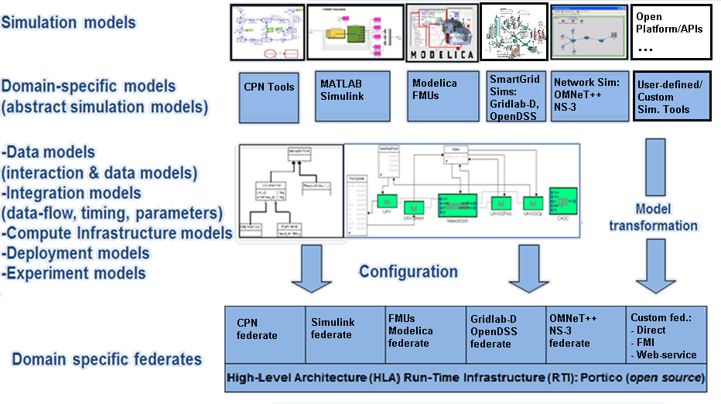
C2WT-TE: Key technology enablers
Vulcan Collaboration Framework
Docker Container Technology
Mesosphere Cluster on OpenStack
Apache Archiva & Maven Build Sys.
Kafka Server, Spark, Weave Routing,..
WebGME Multi-user M & S
Heterogeneous simulation
Distributed simulation
HLA std. based integration
Model-based rapid synthesis
Library of supported tools
Open interface for extension
Library of cyber-attacks
Support for COAs/What-ifs
Experiment specification
Cluster deployment
Analysis tools
C2WT Simulation Integration Framework

Slide 8
Conclusion and Future Work
  C2WT-TE is an “Open” Co-Simulation Platform:
    Flexible, customization, and extensible (plug and play)
    Supports growing library of tools (such as Gridlab-D, OMNeT++, Simulink, CPN,..)
    Supports creation of reusable components with well-defined interfaces
    Provides library of models such as Distribution Models Library, Cyber-Attack Library, and Business Models Library.
    Provides an intuitive web-based collaborative environments for both modeling and analysis.
  The platform provides modeling, experimentation, and analysis facilities that will enable “weaving” of a customized TE simulation by selecting from the tools (already supported or custom added by users) and a library of reusable models with well-defined interfaces!
  Work Ahead:
    Grow library of tools from the power domain such as SGRS, OpenDSS, Simscape, Opal-RT, etc.
    Develop library of simulation models – std. power grid feeder models, business models, consumer models
    Build library of TE scenario models for community, also cyber-attack and defense models
    Collaborate with stakeholders to grow a community of users

Slide 9
References
Cyber-Physical Systems – Virtual Organization: http://cps-vo.org
C2WT-TE Co-Simulation Platform: http://cps-vo.org/group/C2WTTE
Vulcan Forge Project Hosting Platform: http://vulcan.isis.Vanderbilt.edu
WebGME Web-Based Generic Modeling Environment: http://webgme.org
C2WT community wiki – https://wiki.isis.vanderbilt.edu/OpenC2WT
Functional Mock-up Interface – www.fmi-standard.org
HLA standard – IEEE standard for modeling and simulation (M&S) high-level architecture (HLA) – framework and rules http://ieeex-plore.ieee.org/servlet/opac?punumber=7179
NIST's TE Challenge: http://www.nist.gov/smartgrid/techallenge.cfm
TE Challenge Collaboration Site: https://pages.nist.gov/TEChallenge/
DEMO
Neema H., Emfinger W., Dubey A., “A Reusable and Extensible Web-Based Co-Simulation Platform for Transactive Energy Systems,” 3rd Int. Conf. and Workshop on Transactive Energy (TES 2016), Portland, OR, USA, 05/2016.
Hemingway, G., H. Neema, H. Nine, J. Sztipanovits, and G. Karsai, “Rapid Synthesis of High-Level Architecture-Based Heterogeneous Simulation: A Model-Based Integration Approach,” SIMULATION, vol. March 17, 2011 0037549711401950, no. Online, Simulation: Transactions of the Society for Modeling and Simulation International, pp. 16, 03/2011.
H. Neema, H. Nine, G. Hemingway, J. Sztipanovits, and G. Karsai, “Rapid Synthesis of Multi-Model Simulations for Computational Experiments in C2,” Armed Forces Communications and Electronics Association - George Mason University Symposium, issue Critical Issue in C4I, Lansdowne, Virginia.
Neema, H., J. Sztipanovits, M. Burns, and E. Griffor, "C2WT-TE: A Model-Based Open Platform for Integrated Simulations of Transactive Smart Grids", 2016 Workshop on Modeling and Simulation of Cyber-Physical Energy Systems, Vienna, Austria, 04/2016.
H. Neema, G. Karsai, and A. Levis, “Next-Generation Command and Control Wind Tunnel for Courses of Action Simulation,” Technical Report ISIS-15-119, Institute for Software-Integrated Systems, Vanderbilt University, Nashville, TN. May 2015.
J. Sztipanovits, “Composition of cyber-physical systems,” in Proc. of the 14th Annual IEEE Int’l. Conference and Workshops on the Engineering of Computer-Based Systems (ECBS ’07), Washington, DC.

Slide 10
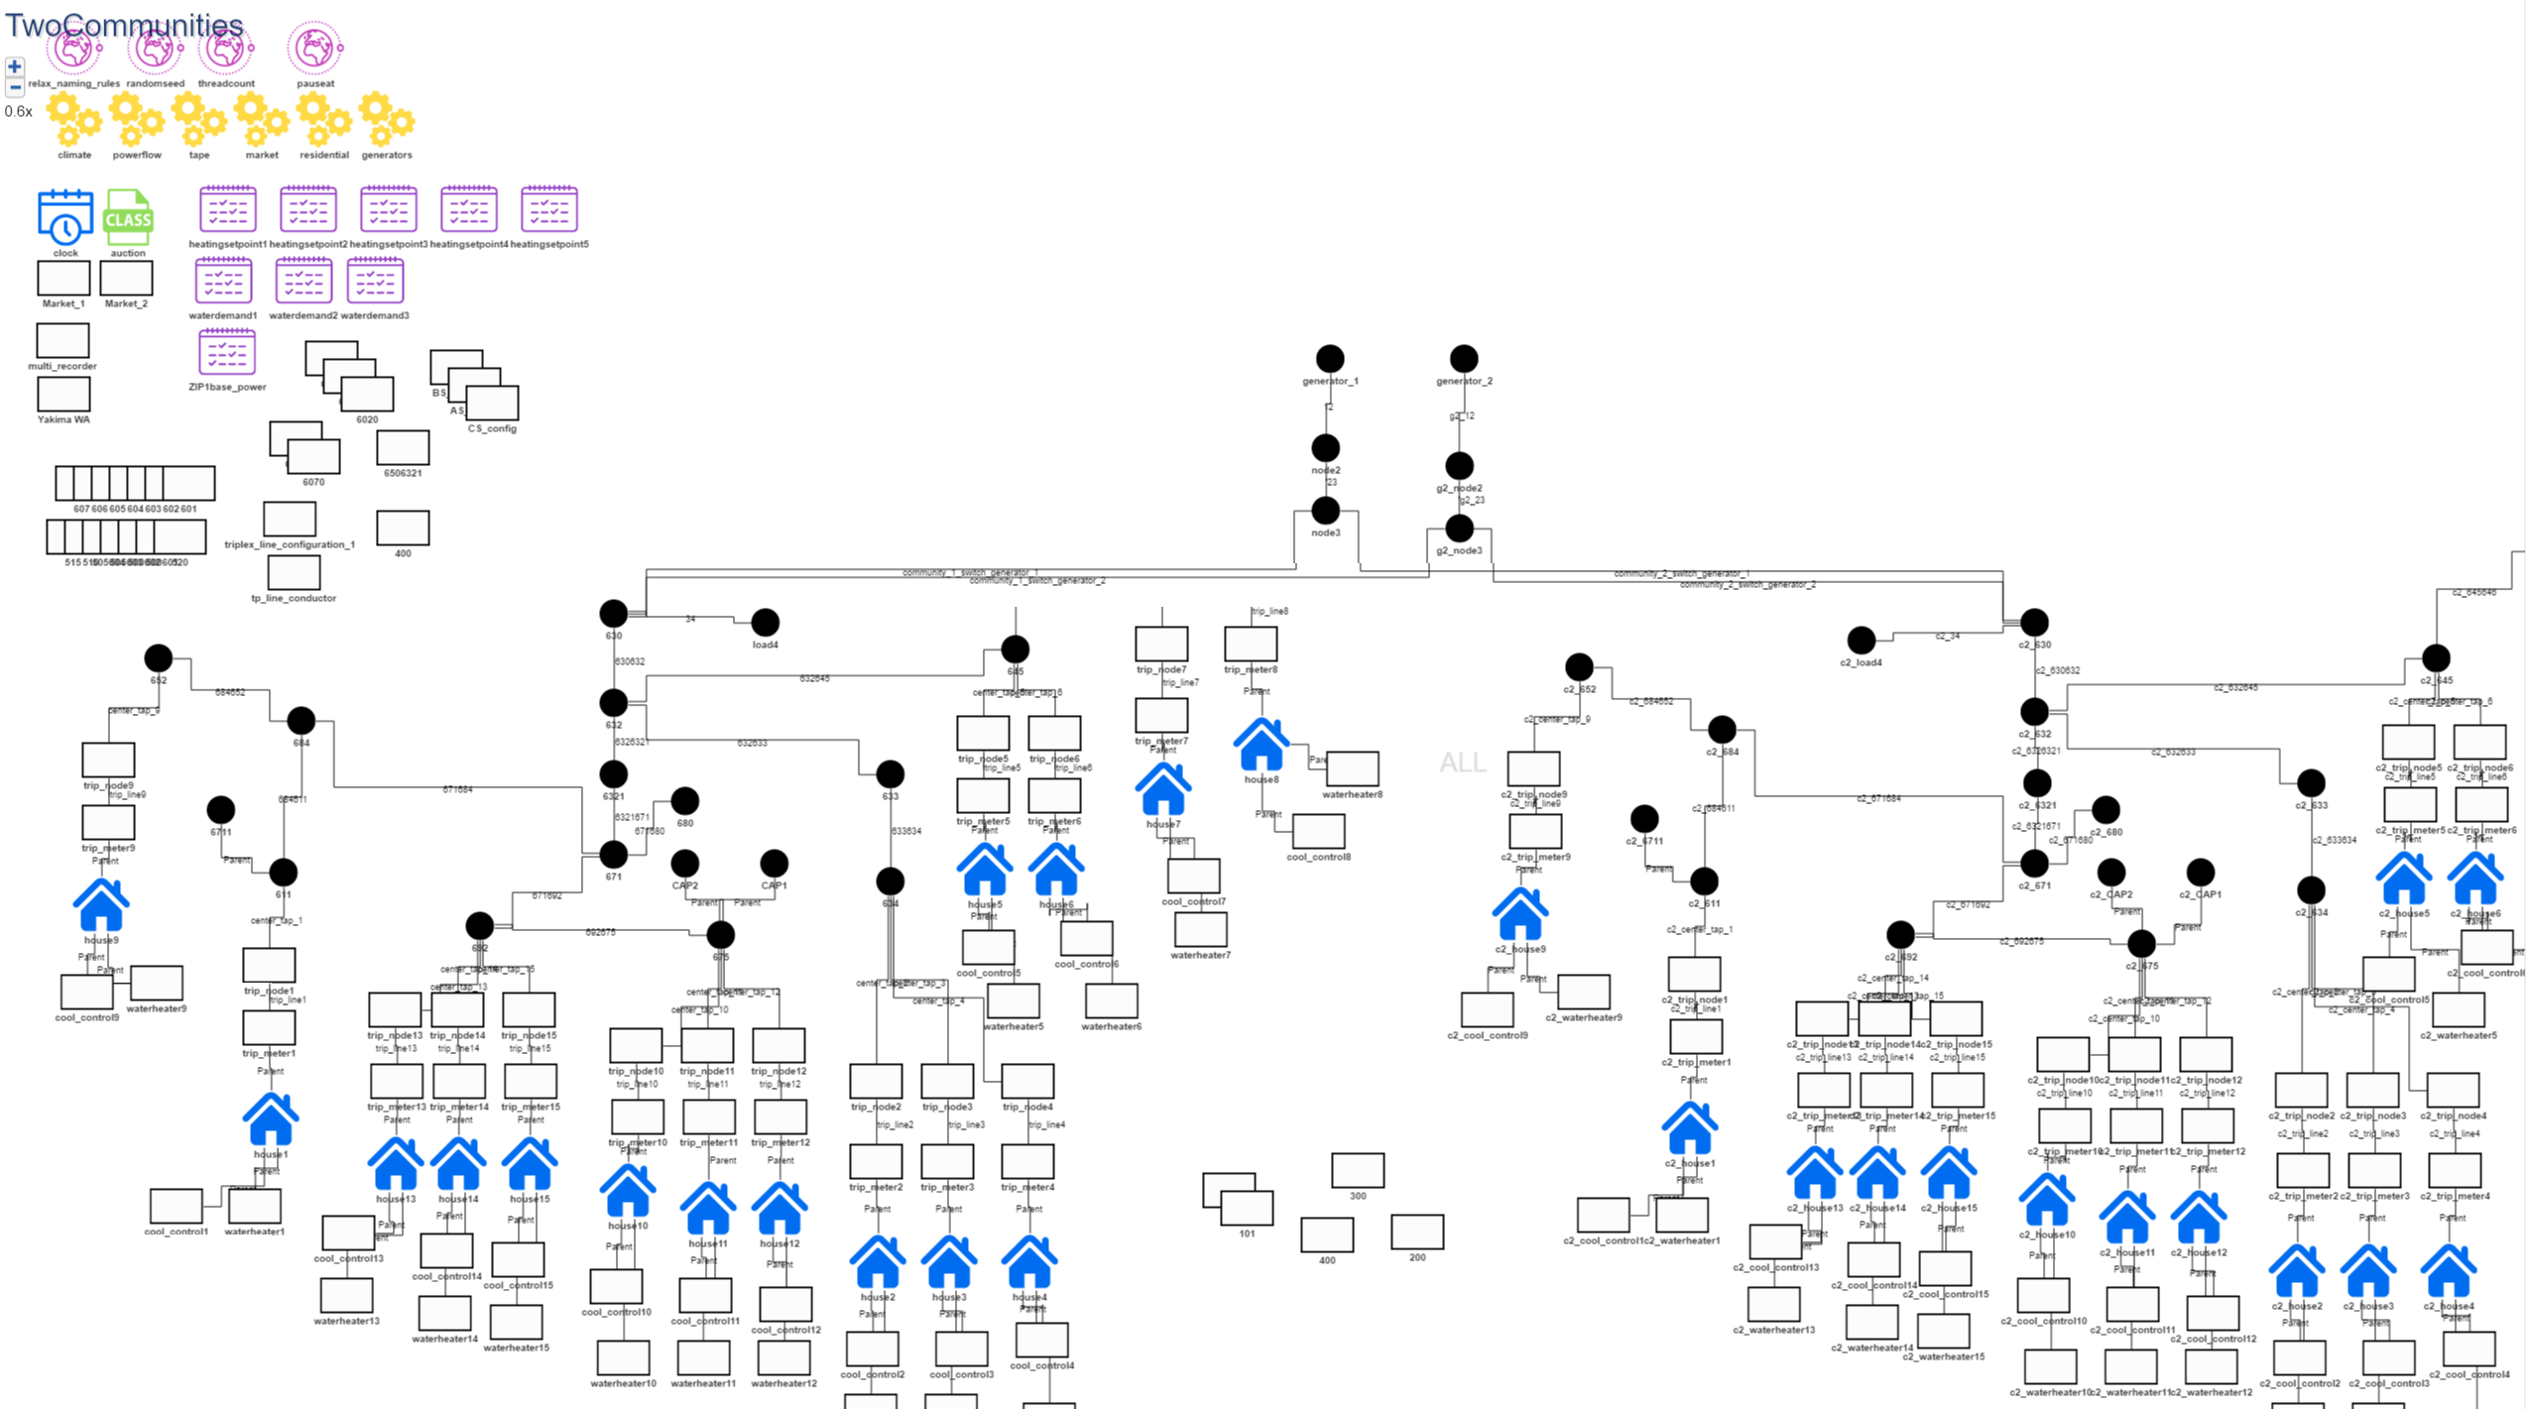
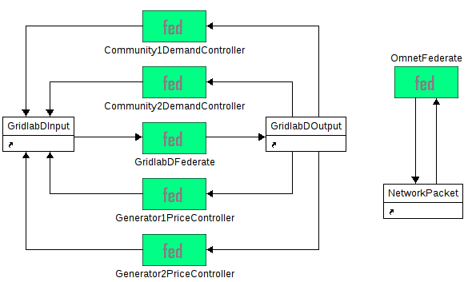
Transactive Energy Integrated Simulation Demo
[Power-grid + Comm. Network + Controllers]

Slide 11
Demo Scenario
Two communities’ micro-grids receiving power from two centralized generators
Communities micro-grids may have local de-centralized power generation and storage
Communities' demand controller selects from available generation sources to meet (i) current load profiles of charging stations, houses, local generation & storage (ii) excess available power at generators and its price
Generator implements reactive price controller and determines power price based on (i) current load of the communities drawing power from it (ii) its power generation profile
Generator's price signals & Communities' load signals use communication network because (i) the system is large & distributed (ii) timing characteristics of these signals is important (iii) can delay and possibly reorder the sensor data packets (iv) another vector for faults to occur/propagate, as well as for attacks
Communities operate independently, but affect each-other through (i) Connected power transmission & distribution network (ii) Communication network between sensors and controllers (iii) Pricing mechanisms of generators & community controllers
Difficult to mathematically/formally analyze, but amenable to simulation
The simulation shows as one generator lowers its price, the communities connected to other generators may switch away from the other generators, which will in turn cause a higher load on the generator with the lowest price (driving its price up) and a lower load on the higher priced generators (driving their prices down).

