Slide 1
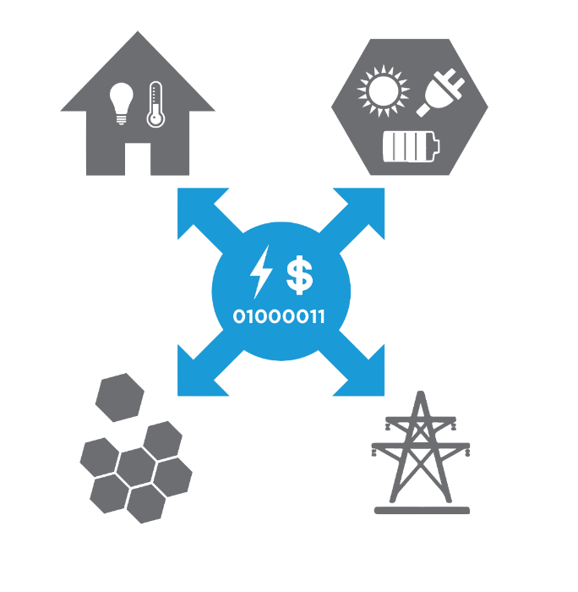





Recipe for a Transactive Energy Implementation for Microgrids
A NIST Transactive Energy Challenge Project
“Transactive Energy for Energy Management in Microgrid Systems”
Presented By:
Jennifer Worrall

Slide 2

Recipe
The new T.E. Microgrids in GridEdge Heights serves up the tastiest energy transactions! We arrived just in time with no reservation and were seated right away at a sun lit window table!
The Daily Tender menu presented by our Market Maker Ed was chock full of highly liquid, energy-rich offers at reasonable prices. Market Facilitator “Chef” Jennifer sources only the most reliable Energy and Transport ingredients from highly qualified suppliers, several of whom were seated at adjacent tables to us, and delivers her fresh offers with a clearly identified shelf life – never a “stale tender” here at TE Microgrids.
Several offers actually expired while we perused the menu and were immediately removed from lack of demand at their initial price point. We eventually went with the plain vanilla 10kWh plate with Carbon REC side, and left fully satisfied after two hours of replenishment.
T.E. Microgrids
Style of Cooking
Utensils
Ingredients
Instructions
Cook Time

Slide 3
Style of Cooking
Common Transactive Services group considered multiple standards-based approaches¹
  Similar types of messages required for each approach (Quote, Tender, Transaction, Delivery)
  All transactive systems will require certain components and functionality
  All transactive systems will have design decisions when creating their market
Focusing on a TeMIX-style implementation for today’s discussion
¹NIST Transactive Energy Challenge CTS Team. (2016, May) Common Transactive Services Report. [Online]. https://github.com/EnergyMashupLab/TransactiveEnergyChallenge/tree/master/CommonTransactiveServices

Slide 4
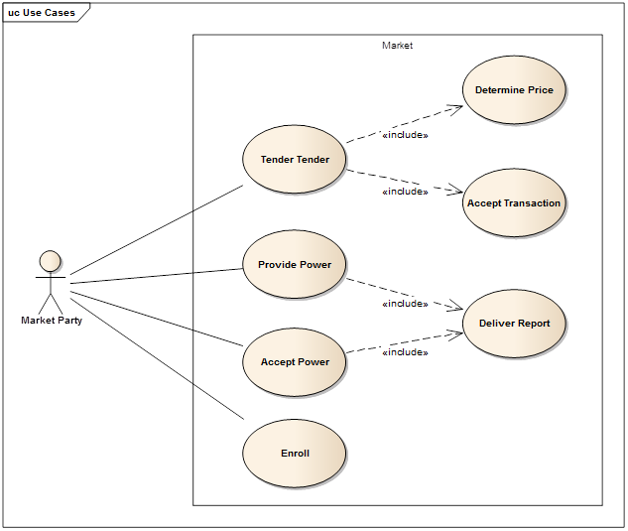
Utensils
Formal software engineering approach used:
Use Cases
Requirements
High Level Design
Future:
Implementation
Test Procedures
Requirements traceability
Documents available at https://github.com/TransactiveEnergy/microgrids
Notes:
Diagram- take out ISO and utility

Slide 5
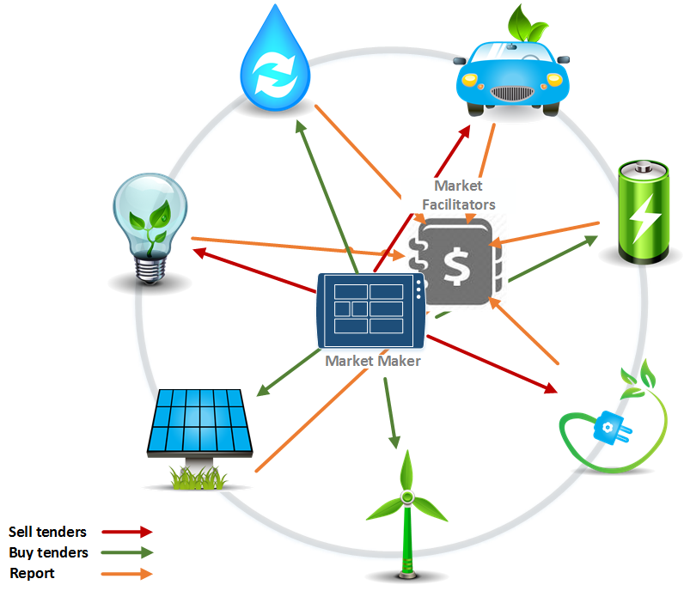
Ingredients
Elements of a Transactive System
Market Participants
  Microgrids
  Storage Devices
  Electric Vehicles
  Internet of Things
  Utility
  Etc.
Market Facilitator(s)
Market Maker(s)

Slide 6
Ingredients
Market Participants
Participants must be able to:
  Forecast usage requirements
  Determine response to tenders
  Control usage based on transactions
  Measure usage
Technical requirements:
  Internet/intranet connectivity
  Create and respond to transactive messages (e.g., CTS, TeMIX, PowerMatcher)
  Respond to messages in a way that meets the market context

Slide 7
Ingredients
Market Facilitator
The facilitator must be able to:
  Authenticate market participants
  Determine if tenders are valid
  Records tenders and transactions
  Determine transaction settlement
Technical requirements
  Internet/intranet connectivity
  Ability to retain transaction records
  Rule processing for compliance to market context
  Ledger functionality

Slide 8
Ingredients
Market Makers
Specialized type of market participant
Help with liquidity and stability
In a TeMIX implementation, market makers frequently send out small buy/sell forward tenders
Market participants can adjust their position by accepting these small tenders

Slide 9
Instructions
Building the Market Context
What products can be transacted?
What is the transaction interval?
How often are tenders created?

Slide 10
Cook Time
Finish reference implementation for ESI and Facilitator
Build simulations
Implement within a microgrid
Implement in a grid-connected setting

Slide 11
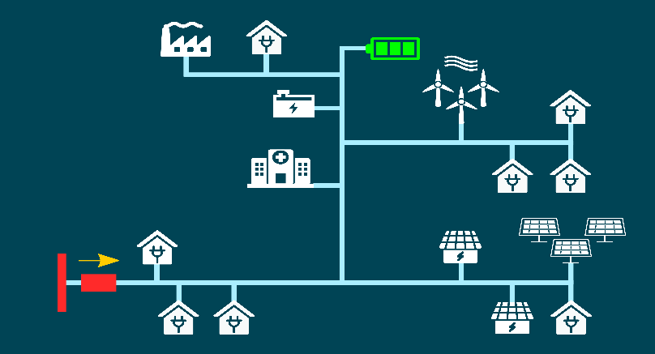
Case Study #1: Flexible Honeycombed Microgrids using Dynamic Microgrid Configurator
Load, DER Schedules
Contingency Scenarios
from historical data
Real Time
Network Events
Network Constraints Private Microgrid Boundaries
Dynamic
Microgrid Configurator
Distribution Network Model
Configuration Repository
For Scenarios
Honeycombed Microgrids Configuration
Implementation is in progress.
A demonstrator of DMC with Event & Report Interfaces has been developed
Interfaces to TE Framework
Event and Report Interfaces

Slide 12

Case Study #2: Brooklyn Microgrid
Participants include 130 buildings—including iconic brownstone houses, public housing towers and schools, along with a grocery store, gas station and fire station
Completely decentralized platform using Ethereum block chain implementation
Goal is to balance the power and loads among the participants of the grid
Live on April 11th, 2016

Slide 13




