Slide 1
Alternative Transactive Electricity Market Models
John Caldwell
Lead, NIST TE Challenge Business and Regulatory Models Team

Slide 2
Four Retail Market Structures
Market-Driven
  Pricing, Programs, & Procurements
  Automated Bilateral Transactions with Two-Way Subscription Retail Tariff
Model-Driven
  LMP+D
  Distributed Marginal Prices (DMP)

Slide 3
A TE System Must Provide…
A method for DER services to be sold to grid and/or traded “peer-to-peer”
A mechanism(s) for pricing products and services
A system for communicating price and other information
An efficient means of allocating electricity and other services, consistent with grid constraints
Appropriate incentives, controls and delegation of responsibilities to ensure that electricity service will continue to be delivered reliably, safely and affordably to all customers

Slide 4
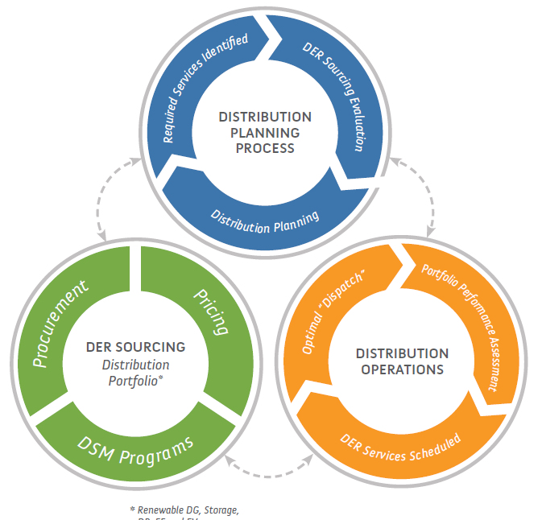
Pricing, Programs and Procurements
Current approach in CA and NY grid services that is analogous to that used for DER under non-wires alternatives under FERC 1000
Current Distribution Operational Services Market:
Utility purchases distribution grid services from 3rd parties to defer grid capital investments & avoid operating expenses
Services sourced either through customer response to time-varying rates and/or services provided under standard offer tariffs, targeted DSM programs or competitive procurements
Future Distributed Energy Market:
Bilateral energy transactions among DER providers, retail energy services providers, load serving entities and prosumers emerging now
But, spot market for residual energy may only emerge when sufficient need & liquidity exists (likely >15 yrs)
Unlikely that dynamic constraint management on distribution grid will be needed before 2030 even in CA or elsewhere due to need & cost-effectiveness

Slide 5
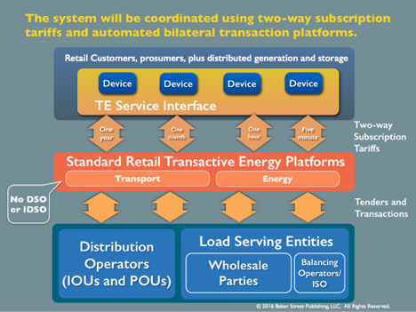
Two-Way Subscription Retail Tariff
Automated Bilateral Transactions
Customers/DER accept long-term subscriptions with DO’s and LSE’s for energy and distribution transport
Two-way transport Tariff recovers more distribution costs when feeders are heavily loaded in either direction
Most energy transactions occur at retail/wholesale interface
Customer/DER buys/sells incremental power at spot price
Structure for Automated Bilateral Transactions with Two-Way Subscription Retail Tariff

Slide 6
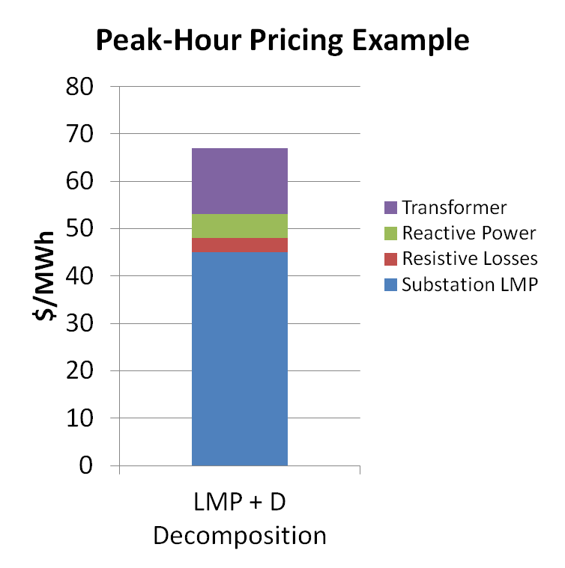
LMP+D
General Features
Derivation of LMP+D
Calculate an adder (D) to the wholesale locational marginal price (LMP)
D = f {voltage, power quality, line losses, etc.}
Calculations are done in “real time”
From example described in M. Caramanis, et. al., “Co-Optimization of Power and Reserves in Dynamic T&D Power Markets with Nondispatchable Renewable Generation and Distributed Energy Resources, Proceedings of the IEEE, 2016

Slide 7
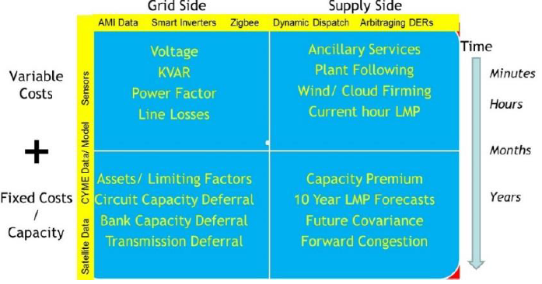
Distribution Marginal Price (DMP)
Derivation of DMP
Use bid-based offers to define short-run DMPs
Long-run DMPs = f {incremental customer needs, distribution costs, bulk grid costs}
Electricity is purchased and sold at nodal DMP in real time
Four Main Components in Distribution Marginal Costs

Slide 8
TE Will Require Viable Business Ecosystem
Sufficient participants to provide level of service >= old system
Prior level of service provided at cost <= old system (New cost-effective infrastructure fusing power and information)
Value of incremental services >= incremental cost to receive;
Change in utility regulatory incentives, valuation/planning methods and grid architecture;
Market transparency, material information disclosure, and liquidity supported by smart grid technologies
Notes:
Must attract sufficient number of entities to provide level of service >= that under old system; Transition from Passive to Proactive Consumers and Prosumers, from inelastic demand to demand elasticity
Prior level of service must be provided in new system at cost <= that under old system; Use Smart Grid technologies to enable cost-effective investments in supportive infrastructure.
Value of incremental services must be >= incremental cost to receive them; Transition to a “Customer-Driven” Paradigm that changes the way in which “value” is measured
Change Incentives within Electricity Regulatory System; Change Methods for Valuation and Planning; Architectural Design and Rules
Incent Smart Grid investments to enable transparency, provision of material information and liquidity in the marketplace

Slide 9
What Will Drive Adoption of a TE System?
Aggressive clean energy goals/policies integrated into electricity system
DER market penetration strains capability of utility to manage DER under existing system
Commitment by regulators/legislators
Workable/comprehensible/affordable roadmaps for implementation
“Grassroots” TE development (e.g., microgrids, consumer behavior, information sharing protocols)
Somebody else actually does it!!!
Notes:
Aggressive clean energy goals/policies integrated into Electricity System planning, operations and trading
Higher DER market penetration strains capability of utility to manage DER under existing system; fusion of power and information systems increases the complexity of power system
Commitment by regulators/legislators to change Utility Incentives (risks/rewards) to be indifferent to evaluating cost-effective options for optimizing allocation of resources subject to grid constraints and to create long-term customer value
Workable/comprehensible/affordable roadmaps for implementation to support investment into a functional decentralized supply/demand model, using smart grid technologies to modernize grid design and pilots to test/validate models
“Grassroots” TE development (e.g., microgrids); Shape Consumer Behavior; Develop Data/Information Sharing Protocols for market transactions to be informed by material information
Increase role of “Smart Grid” to enable supportive grid design; market design; control engineering; communication, information and data generation and management

