Slide 1

Enabling Standards for Demand Side Management
Productizing Transactive Energy Signals
Rolf Bienert
Technical Director OpenADR Alliance

Slide 2
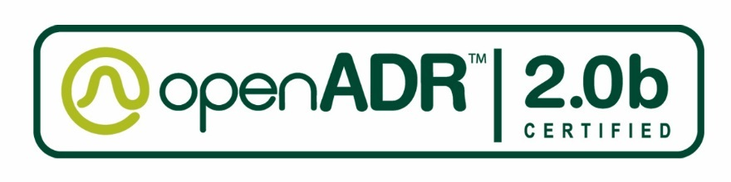
What is the OpenADR Alliance?
Membership organization with 140+ national and international member companies
California based nonprofit corporation
Leverages Smart Grid related standards from OASIS, IEC, UCA and NAESB for OpenADR profiles
Supports development, testing, certification, and deployment of commercial OpenADR
Enables stakeholders to participate in automated DR, dynamic pricing, and electricity grid reliability

Slide 3
Why have an industry alliance?
Branding
  Technology will not succeed without brand awareness and marketing
Interoperability, testing, certification
  The market needs a solid program that makes systems interoperable on the interface point
Outreach, training, education
Typical goals of an industry alliance
  Build a reliable technology
  Create new markets for members
  Increase membership → market acceptance

Slide 4
What we did with OpenADR?
OpenADR 2.0 is a profile of the OASIS Energy Interoperation (EI)
Further “profiled” the EI functions and models
  Added conformance statements to increase interoperability
  Created the OpenADR 2.0a/b Profile Specifications
  Added transport protocols and security
  Created a test plan and certification policy
  Build a test tool for pre- and certification testing
Created a certification program
  Test plan
  Test tool
  Certification requirements
  Logo
  SGIP ITCA (Interoperability Testing and Certification Agency)

Slide 5
Transactive ADR Team
Goal: advance TE in OpenADR Alliance, with goals of leveraging established DR member alliance (OpenADR Alliance) to create an industry solution for TE
Extending the OpenADR standard to include TE, pointing the way to a practical future for TE
Engaging both new and existing OpenADR members in the creation of Transactive Automated DR (TADR)
Integrating IoT transactive framework with DR
Synchronize with California Energy Commission efforts

Slide 6
Transactive ADR Team (2)
Who: TE Challenge participants + OpenADR members: We are open for participants
Collective agreement on how to advance TE in the OpenADR Alliance
Agreement on what transactive piece (“extension” or “OpenADR profile”, etc.) will be developed in OpenADR and how
Identify ties to other TE Challenge teams and any related work items

Slide 7
The starting point
Team Output from TE for Energy management in Microgrid Systems
Market Participants
  Microgrids
  Storage Devices
  Electric Vehicles
  Internet of Things
  Utility
  Etc.
Required messages: Quote, Tender, Transaction, Delivery
All available but will need to be profiled
Join the effort!

Slide 8
Rolf Bienert rolf@openadr.org www.openadr.org
+1 (925) 336-0239
Thank you!

